Slide 1

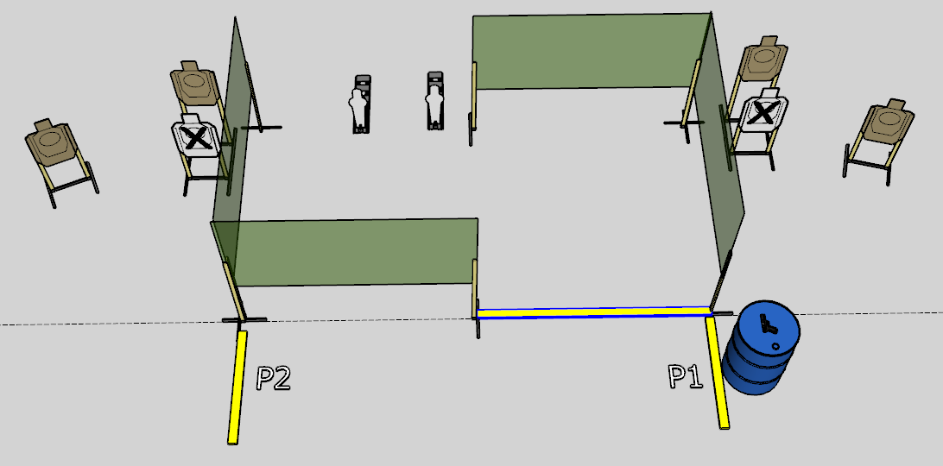
 | Interlake Sporting Association North Pistol, B Stage: I Wanna Be A Grand Master When I Grow Up Course Designer: Stanley Lewis
START POSITION: Firearm loaded and placed on barrel with muzzle pointed downrange and safety on. Shooter standing behind barrel with hands touching rim.
STAGE PROCEDURE: At the start signal, move into the cover of P1 and engage T1 and T2. Engage PP1 and PP2 from behind the fault lines, then engage T3 and T4 from P2. Reload required between first and last shot. |  | STRINGS: 1 SCORING: Unlimited SCORED HITS: 6 START-STOP: Audible - Last shot

